Slide 1
Communication between microservices
CYLai IESD-0B

Slide 2
What is Micro service

Slide 3
What is Micro service
Monolith to micro service

Slide 4
Some Principles Regarding Micro service
Each Microsrvices should only be responsible for a single function or process
Microservices shouldn't share code or data
Independence and autonomy are more important than code re-usability.
Plan more, code less
Anti-Pattern
Everything should be micro EXCEPT the DB.
Microservice will magically solve poor development practices.
There's no need for coordination between dev. teams.
Making the technologies behind the microservices your key focus.

Slide 5
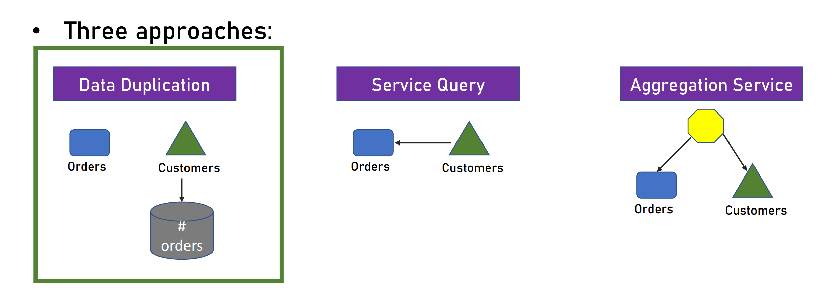
Example of communication
Query all customer from Hsinchu with their total order number
Customer service and order service
Two data bases
The result are composed by two sources

Slide 6
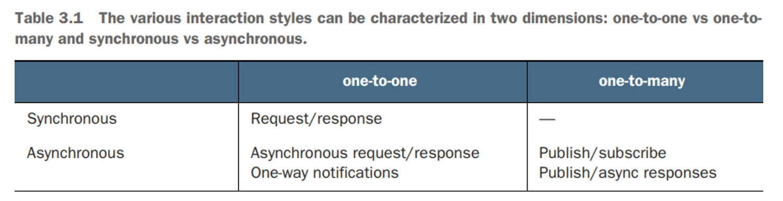
IPC – Inter Process Communication
Efficient communication between services is crucial
It’s important to choose the correct communication pattern
NOT the async http call like we used in javascript​

Slide 7
Sync communication
Pros
Immediate response
Error handling
Easy to implement
Cons
Performances
Cascaded waiting issue

Slide 8
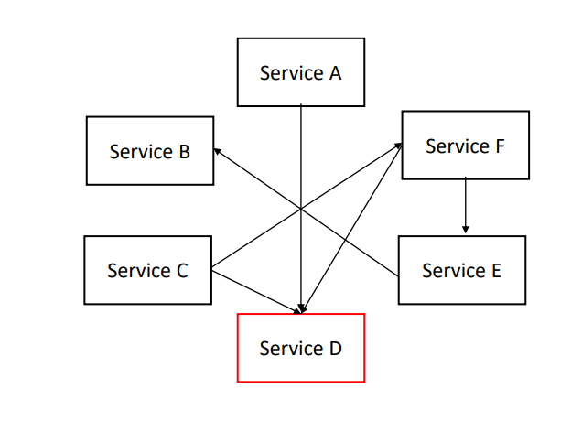
Sync communication
Each service directly connect to the others
What if service D is changed (like URL)?

Slide 9
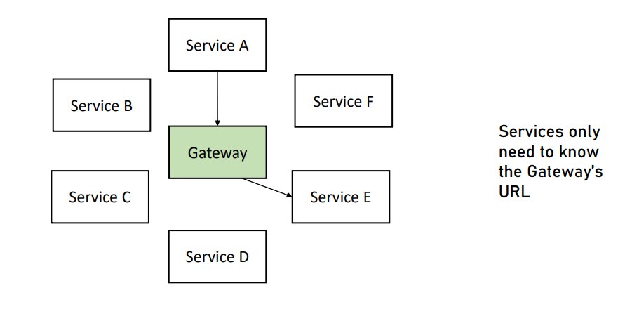
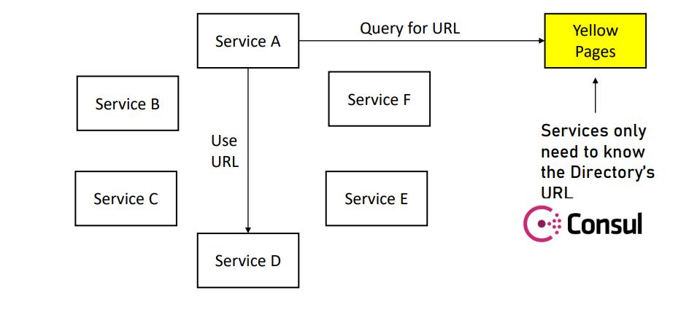

Slide 10
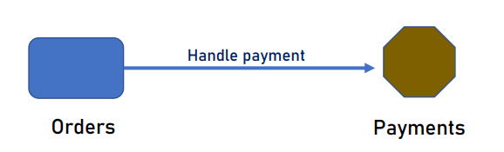
Async communication
NOT the async http call in js
Fire and Forget
Does't wait for reponse
When to use?
A service command another one to do something and the first service doesn't take care about the result

Slide 11
Async communication

Slide 12
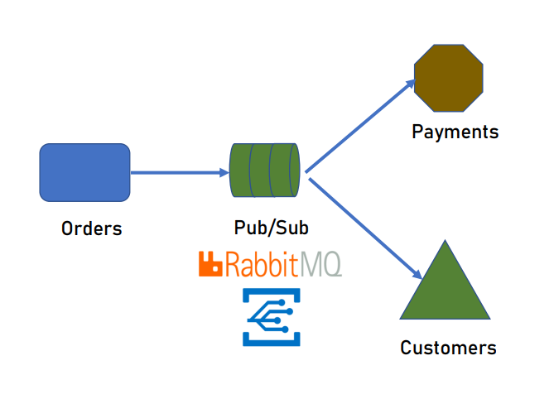

Slide 13
Short summary
We can apply different approach in our system
Querying data, creating data, and etc. can apply different pattern
CQRS and event driven bus

Slide 14
CQRS

Slide 15
event driven bus

Slide 16
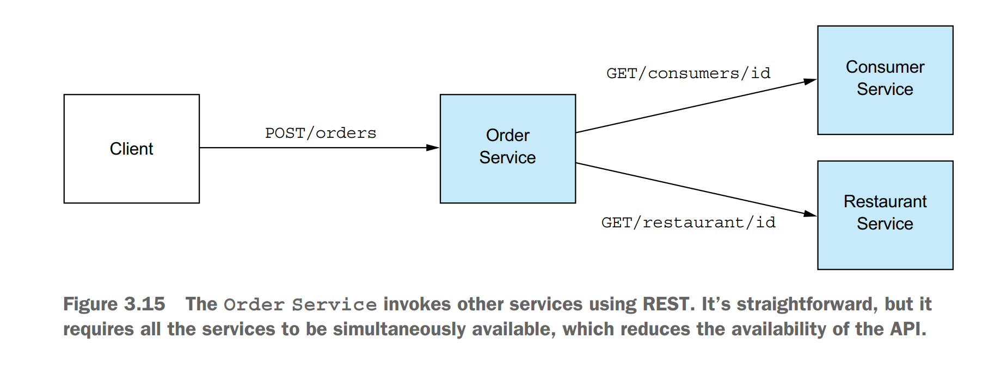
Downside of sync communication
The more services involved in the system, the less availability.

Slide 17
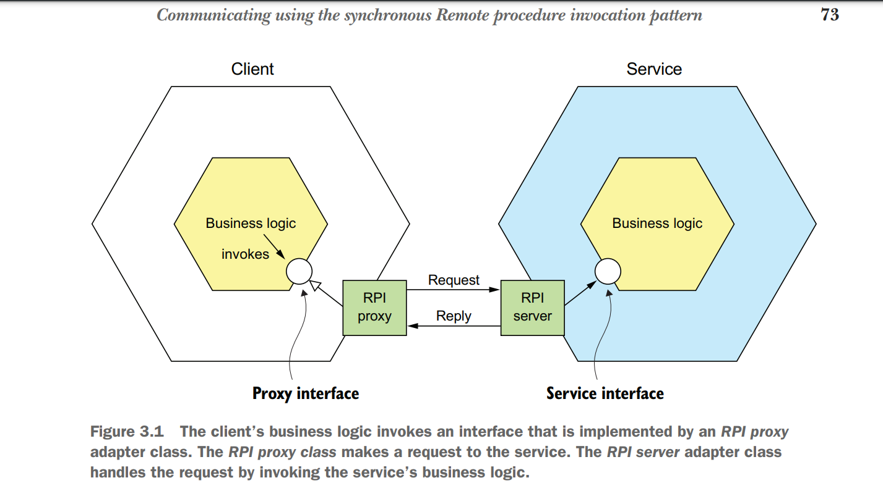
Synchrous RPI
Sync way to communicate with Server
REST
GPRC
RPI proxy in between client and server
Using unified protocol to communicate

Slide 18
Issuse of REST
REST resources are usually oriented around business objects, such as Consumer and Order.
A common problem when designing a REST API is how to enable the client to retrieve multiple related objects in a single request.
This issue led to the increasing popularity of alternative API technologies such as GraphQL and Falcor

Slide 19
Communications
Client-to-Server commnunication
Event driven communication
Message commnunication

Slide 20
Client-to-Server commnunication
API Gateway
An entry point from client to micro services
Act like a reverse proxy that route requests to the desired micro service
Why API Gateway?

Slide 21
Service-to-Service communication
Async and Event driven bus

Slide 22
Datamanagement
Async and Event driven bus
CQRS Pattern(Command Query Responsibility Segregation)
Event sourcing pattern
SAGA pattern

Slide 23
Turn to the DSC services
Perhaps we

